Slide 1
Eschemyst
Dissertations theses made by Cuc Robert Vasile
Scientific coordinators:
S.I.dr.ing Setlian – Nicolae NICOLA
Asist. drd. ing. Grosu Mihai Alexandru
UPT – AC – GD - 2025

Slide 2
Table of contents
01
02
03
Introduction
Mechanics
Methodology
04
05
06
Implementation
Objectives
Conclusion

Slide 3
Introduction
Eschemyst is a 3D, Low Poly, role playing game in first person focused on the alchemy crafting mechanic, and the game is set in a medieval fictional world, where the protagonist is being held in a prison by some goblins.
The goal is to escape from the prison.
Notes:
Pitch : 3D – First person – main mechanic is alchemy crafting
Goal : Escape the confinement
The prison is full of alchemy equipment
The goblins are using you as a ‘cook’ giving you potions requests each day
Why this idea :
I love brewing potions
Fun to combine
Lots of potential

Slide 4
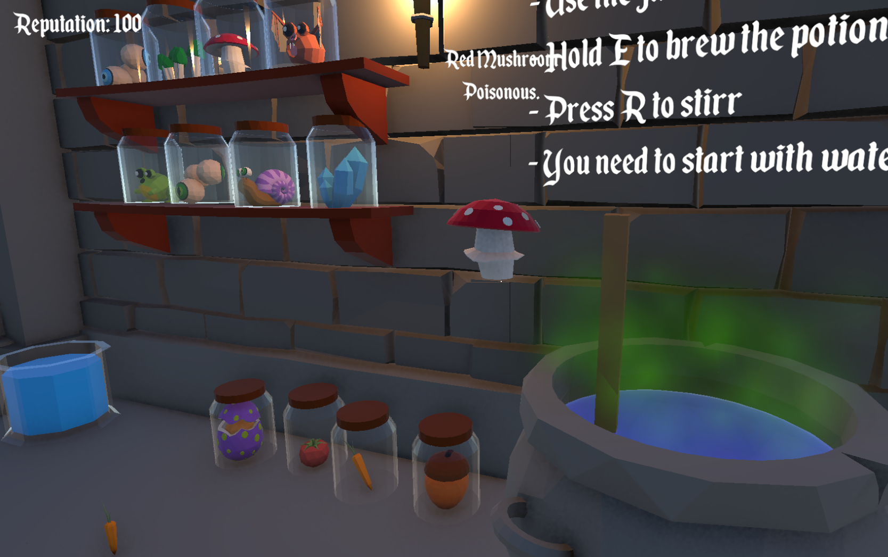
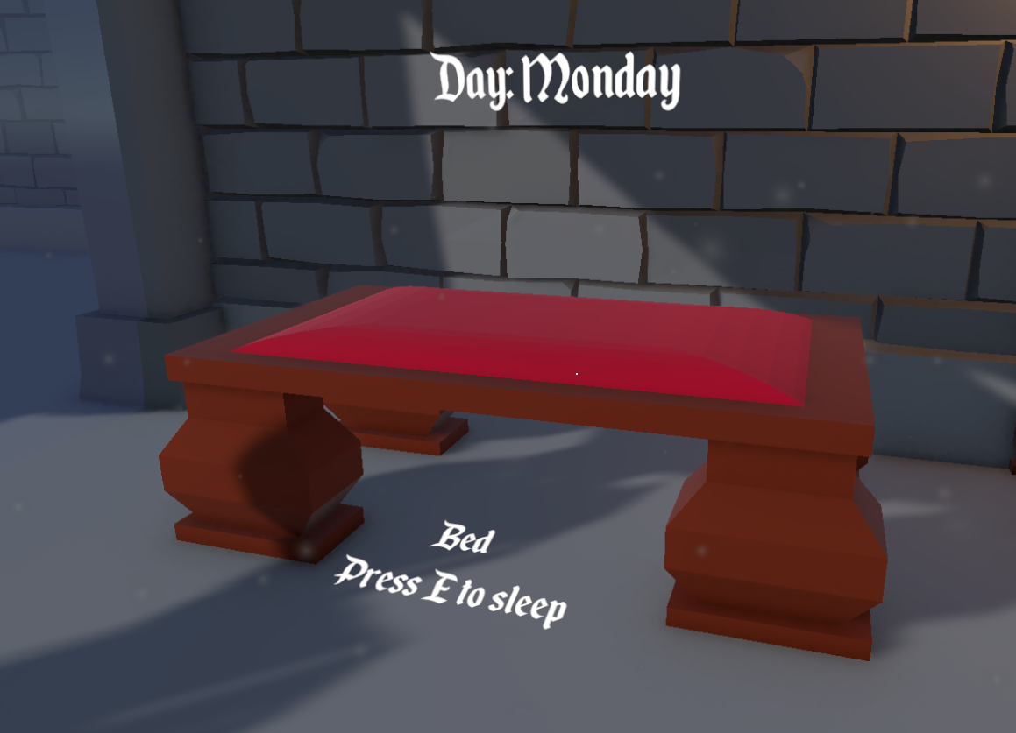
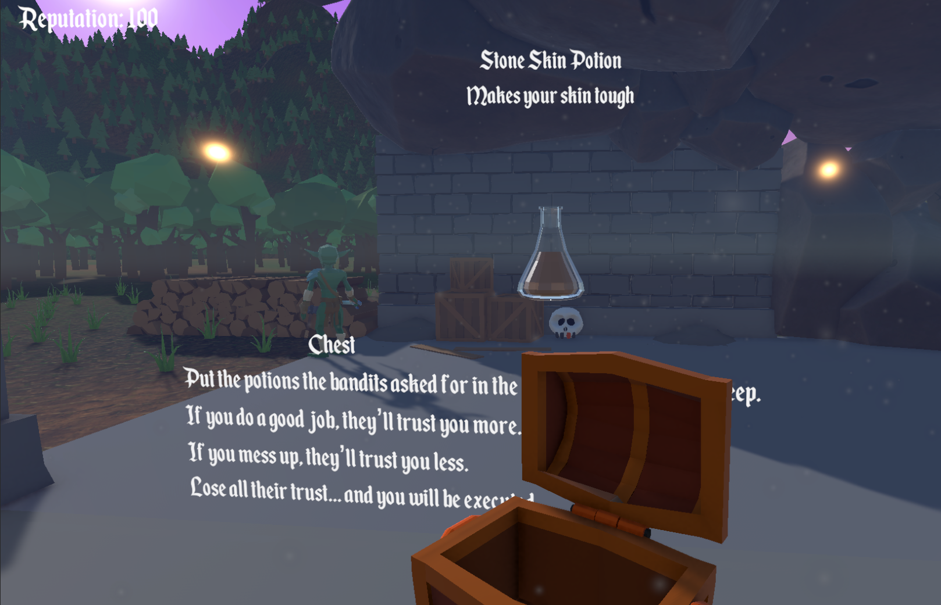
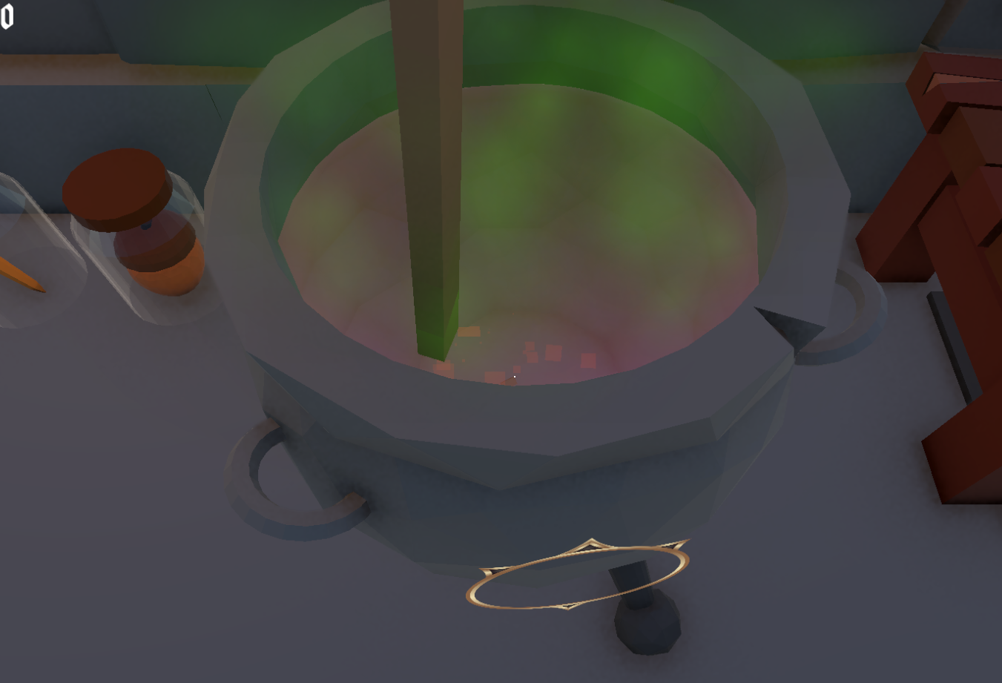

Slide 5
02.
Game Mechanics

Slide 6
The core mechanic of the game is potion crafting!
Interacting with objects with Phisics system.
Sleeping to advance day.
Gathering special ingredients.
3D Audio mechanics.
Notes:
Brewing, Ingredients, stir, grind
You hold objects similar to Bethesda games
A 7 day system, where you don’t work on Sundays
Collecting special ingredients to help you out of the prison
3D Audio, where you hear the sound in certain places

Slide 7
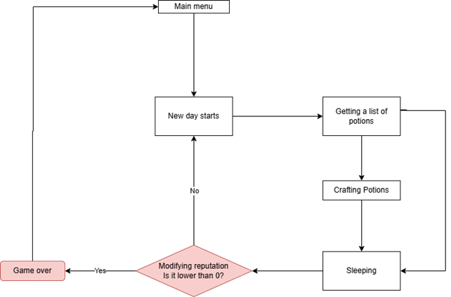

Slide 8
Methodology
03.

Slide 9





Platform: Pc
Made in: Unity Version 6.0 [C#]
Music Editor: AudioMass
Assets: Unity Asset Store
About the development Process
Notes:
Development process
The game had its milestones
A task list
Management
Talk about the GDD

Slide 10
Implementation
04.

Slide 11
How potions and ingredients work?
How does the cauldron work?
How does the Stirring and Grinding work
What happens each day?
How I tried optimizing the Game?
Notes:
Ingredients, potions : Scriptable object
Talk about the cauldron and how it registers IDs
Stirring adds -1 to the ID list, griding multiplies the id by 100 to get a new ID
Each day, changes the Ui text and potion requirements
I optimized the code by keeping the code as clean as possible
Talk about the Low poly obj and about the LOD / Max POV

Slide 12
Objectives
05.

Slide 13
Make a game that’s fun to play
Learn Unity and how to improve my game development
Build a playable prototype
Notes:
I watched a lot of tutorials
I plan to post this game on itchio as a free game [As a CV]
My main objective for this dissertation was to make a game that can be played from start-finish

Slide 14
Conclusion
06.

Slide 15
Working alone proved to be a nice experience!
Learned a lot while working on this project
Things that I would’ve improved
Notes:
Working alone : Not used to everything
LEARNED : I also came up with my own ideas that came out to be pretty efficient
IMPROVEMENTS:
Story telling
More player freedom in crafting potions
Working on an “upgrade system” [Improving cauldron/mortar efficiency ]
Add more challenges / minigames

Slide 16
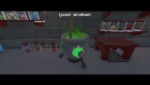

Slide 17
Thank you for your attention!
Do you have any questions?

